Slide 1
Object-Oriented Software Engineering
Practical Software Development using UML and Java
Chapter 10:
Testing and Inspecting to Ensure High Quality

Slide 2
10.1 Basic definitions
  A failure is an unacceptable behaviour exhibited by a system
    The frequency of failures measures the reliability
    An important design objective is to achieve a very low failure rate and hence high reliability.
    A failure can result from a violation of an explicit or implicit requirement
  A defect is a flaw in any aspect of the system that contributes, or may potentially contribute, to the occurrence of one or more failures
    could be in the requirements, the design and the code
    It might take several defects to cause a particular failure
  An error is a slip-up or inappropriate decision by a software developer that leads to the introduction of a defect

Slide 3
10.2 Effective and Efficient Testing
To test effectively, you must use a strategy that uncovers as many defects as possible.
To test efficiently, you must find the largest possible number of defects using the fewest possible tests
  Testing is like detective work:
    The tester must try to understand how programmers and designers think, so as to better find defects.
    The tester must not leave anything uncovered, and must be suspicious of everything.
    It does not pay to take an excessive amount of time; tester has to be efficient.

Slide 4
Glass-box testing
Also called ‘white-box’ or ‘structural’ testing
Testers have access to the system design
  They can
    Examine the design documents
    View the code
    Observe at run time the steps taken by algorithms and their internal data
  Individual programmers often informally employ glass-box testing to verify their own code

Slide 5
Flow graph for glass-box testing
To help the programmer to systematically test the code
  Each branch in the code (such as if and while statements) creates a node in the graph
  The testing strategy has to reach a targeted coverage of statements and branches; the objective can be to:
    cover all possible paths (often infeasible)
    cover all possible edges (most efficient)
    cover all possible nodes (simpler)

Slide 6
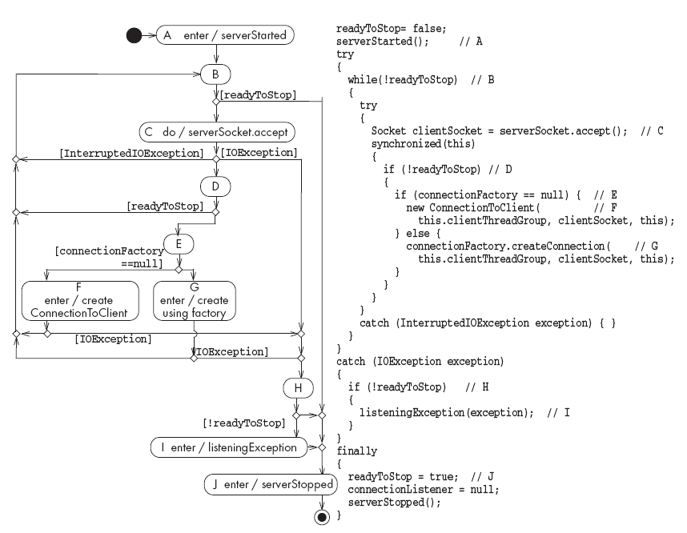
Flow graph for glass-box testing

Slide 7
Black-box testing
Testers provide the system with inputs and observe the outputs
  They can see none of:
    The source code
    The internal data
    Any of the design documentation describing the system’s internals

Slide 8
Equivalence classes
  It is inappropriate to test by brute force, using every possible input value
    Takes a huge amount of time
    Is impractical
    Is pointless!
  You should divide the possible inputs into groups which you believe will be treated similarly by all algorithms.
    Such groups are called equivalence classes.
    A tester needs only to run one test per equivalence class
    The tester has to
      understand the required input,
      appreciate how the software may have been designed

Slide 9
Examples of equivalence classes
  Valid input is a month number (1-12)
    Equivalence classes are: [-∞..0], [1..12], [13.. ∞]
  Valid input is one of ten strings representing a type of fuel
    Equivalence classes are
      10 classes, one for each string
      A class representing all other strings

Slide 10
Combinations of equivalence classes
  Combinatorial explosion means that you cannot realistically test every possible system-wide equivalence class.
    If there are 4 inputs with 5 possible values there are 5⁴ (i.e. 625) possible system-wide equivalence classes.
  You should first make sure that at least one test is run with every equivalence class of every individual input.
  You should also test all combinations where an input is likely to affect the interpretation of another.
  You should test a few other random combinations of equivalence classes.

Slide 11
Example equivalence class combinations
  One valid input is either ‘Metric’ or ‘US/Imperial’
    Equivalence classes are:
      Metric, US/Imperial, Other
  Another valid input is maximum speed: 1 to 750 km/h or 1 to 500 mph
    Validity depends on whether metric or US/imperial
    Equivalence classes are:
      [-∞..0], [1..500], [501..750], [751.. ∞]
  Some test combinations
      Metric, [1..500] valid
      US/Imperial, [1..500] valid
      Metric, [501..750] valid
      US/Imperial, [501..750] invalid

Slide 12
Testing at boundaries of equivalence classes
  More errors in software occur at the boundaries of equivalence classes
  The idea of equivalence class testing should be expanded to specifically test values at the extremes of each equivalence class
    E.g. The number 0 often causes problems
  E.g.: If the valid input is a month number (1-12)
    Test equivalence classes as before
    Test 0, 1, 12 and 13 as well as very large positive and negative values

Slide 13
Detecting specific categories of defects
A tester must try to uncover any defects the other software engineers might have introduced.
  This means designing tests that explicitly try to catch a range of specific types of defects that commonly occur

Slide 14
10.3 Defects in Ordinary Algorithms
Incorrect logical conditions
  Defect:
    The logical conditions that govern looping and if-then-else statements are wrongly formulated.
  Testing strategy:
    Use equivalence class and boundary testing.
    Consider as an input each variable used in a rule or logical condition.

Slide 15
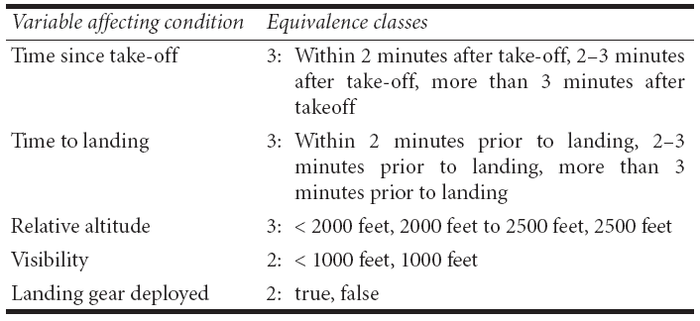
Example of incorrect logical conditions defect
  The landing gear must be deployed whenever the plane is within 2 minutes from landing or takeoff, or within 2000 feet from the ground. If visibility is less than 1000 feet, then the landing gear must be deployed whenever the plane is within 3 minutes from landing or lower than 2500 feet
    Total number of system equivalence classes: 108

Slide 16
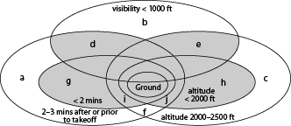
Example of incorrect logical conditions defect
What is the hard-to-find defect in the following code?
if(!landingGearDeployed &&
(min(now-takeoffTime,estLandTime-now))<
(visibility < 1000 ? 180 :120) ||
relativeAltitude <
(visibility < 1000 ? 2500 :2000)
)
{
throw
new LandingGearException();
}

Slide 17
Defects in Ordinary Algorithms
Performing a calculation in the wrong part of a control construct
  Defect:
    The program performs an action when it should not, or does not perform an action when it should.
    Typically caused by inappropriately excluding or including the action from a loop or a if construct.
  Testing strategies:
    Design tests that execute each loop zero times, exactly once, and more than once.
    Anything that could happen while looping is made to occur on the first, an intermediate, and the last iteration.

Slide 18
Example of performing a calculation in the wrong part of a control construct
while(j<maximum)
{
k=someOperation(j);
j++;
}
if(k==-1) signalAnError();
if (j<maximum)
doSomething();
if (debug) printDebugMessage();
else doSomethingElse();

Slide 19
Defects in Ordinary Algorithms
Not terminating a loop or recursion
  Defect:
    A loop or a recursion does not always terminate, i.e. it is ‘infinite’.
  Testing strategies:
    Analyse what causes a repetitive action to be stopped.
    Run test cases that you anticipate might not be handled correctly.

Slide 20
Defects in Ordinary Algorithms
Not setting up the correct preconditions for an algorithm
  Defect:
    Preconditions state what must be true before the algorithm should be executed.
    A defect would exist if a program proceeds to do its work, even when the preconditions are not satisfied.
  Testing strategy:
    Run test cases in which each precondition is not satisfied.

Slide 21
Defects in Ordinary Algorithms
Not handling null conditions
  Defect:
    A null condition is a situation where there normally are one or more data items to process, but sometimes there are none.
    It is a defect when a program behaves abnormally when a null condition is encountered.
  Testing strategy:
    Brainstorm to determine unusual conditions and run appropriate tests.

Slide 22
Defects in Ordinary Algorithms
Not handling singleton or non-singleton conditions
  Defect:
    A singleton condition occurs when there is normally more than one of something, but sometimes there is only one.
    A non-singleton condition is the inverse.
    Defects occur when the unusual case is not properly handled.
  Testing strategy:
    Brainstorm to determine unusual conditions and run appropriate tests.

Slide 23
Defects in Ordinary Algorithms
Off-by-one errors
  Defect:
    A program inappropriately adds or subtracts one.
    Or loops one too many times or one too few times.
    This is a particularly common type of defect.
  Testing strategy:
    Develop tests in which you verify that the program:
      computes the correct numerical answer.
      performs the correct number of iterations.

Slide 24
Example of off-by-one defect
for (i=1; i<arrayname.length; i++)
{
/* do something */
}
Use Iterators to help eliminate these defects
while (iterator.hasNext())
{
anOperation(++val);
}

Slide 25
Defects in Ordinary Algorithms
Operator precedence errors
  Defect:
    An operator precedence error occurs when a programmer omits needed parentheses, or puts parentheses in the wrong place.
    Operator precedence errors are often extremely obvious...
      but can occasionally lie hidden until special conditions arise.
    E.g. If x*y+z should be x*(y+z) this would be hidden if z was normally zero.
  Testing:
    In software that computes formulae, run tests that anticipate such defects.

Slide 26
Defects in Ordinary Algorithms
Use of inappropriate standard algorithms
  Defect:
    An inappropriate standard algorithm is one that is unnecessarily inefficient or has some other property that is widely recognized as being bad.
  Testing strategies:
    The tester has to know the properties of algorithms and design tests that will determine whether any undesirable algorithms have been implemented.

Slide 27
Example of inappropriate standard algorithms
  An inefficient sort algorithm
    The most classical ‘bad’ choice of algorithm is sorting using a so-called ‘bubble sort’
  An inefficient search algorithm
    Ensure that the search time does not increase unacceptably as the list gets longer
    Check that the position of the searched item does not have a noticeable impact on search time.
  A non-stable sort
  A search or sort that is case sensitive when it should not be, or vice versa

Slide 28
10.4 Defects in Numerical Algorithms
Not using enough bits or digits
  Defect:
    A system does not use variables capable of representing the largest values that could be stored.
    When the capacity is exceeded, an unexpected exception is thrown, or the data stored is incorrect.
  Testing strategies:
    Test using very large numbers to ensure the system has a wide enough margin of error.

Slide 29
Defects in Numerical Algorithms
Not using enough places after the decimal point or significant figures
  Defects:
    A floating point value might not have the capacity to store enough significant figures.
    A fixed point value might not store enough places after the decimal point.
    A typical manifestation is excessive rounding.
  Testing strategies:
    Perform calculations that involve many significant figures, and large differences in magnitude.
    Verify that the calculated results are correct.

Slide 30
Defects in Numerical Algorithms
Ordering operations poorly so errors build up
  Defect:
    A large number does not store enough significant figures to be able to accurately represent the result.
  Testing strategies:
    Make sure the program works with inputs that have large positive and negative exponents.
    Have the program work with numbers that vary a lot in magnitude.
      Make sure computations are still accurately performed.

Slide 31
Defects in Numerical Algorithms
Assuming a floating point value will be exactly equal to some other value
  Defect:
    If you perform an arithmetic calculation on a floating point value, then the result will very rarely be computed exactly.
    To test equality, you should always test if it is within a small range around that value.
  Testing strategies:
    Standard boundary testing should detect this type of defect.

Slide 32
Example of defect in testing floating value equality
Bad:
for (double d = 0.0; d != 10.0; d+=2.0) {...}
Better:
for (double d = 0.0; d < 10.0; d+=2.0) {...}

Slide 33
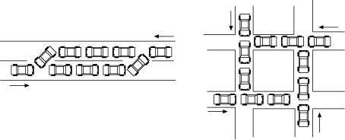
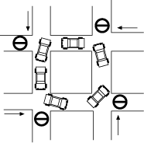
10.5 Defects in Timing and Co-ordination
Deadlock and livelock
  Defects:
    A deadlock is a situation where two or more threads are stopped, waiting for each other to do something.
      The system is hung
    Livelock is similar, but now the system can do some computations, but can never get out of some states.

Slide 34
Defects in Timing and Co-ordination
Deadlock and livelock
  Testing strategies:
    Deadlocks and livelocks occur due to unusual combinations of conditions that are hard to anticipate or reproduce.
    It is often most effective to use inspection to detect such defects, rather than testing alone.
    However, when testing:
      Vary the time consumption of different threads.
      Run a large number of threads concurrently.
      Deliberately deny resources to one or more threads.

Slide 35
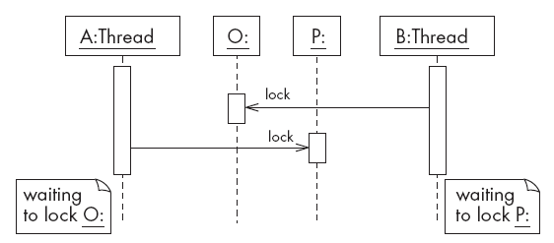
Example of deadlock

Slide 36
Defects in Timing and Co-ordination
Critical races
  Defects:
    One thread experiences a failure because another thread interferes with the ‘normal’ sequence of events.
  Testing strategies:
    It is particularly hard to test for critical races using black box testing alone.
    One possible, although invasive, strategy is to deliberately slow down one of the threads.
    Use inspection.

Slide 37
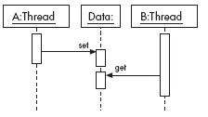
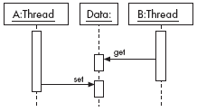
Example of critical race
a) Normal
b) Abnormal due to delay in thread A

Slide 38
Semaphore and synchronization
Critical races can be prevented by locking data so that they cannot be accessed by other threads when they are not ready
  One widely used locking mechanism is called a semaphore.
  In Java, the synchronized keyword can be used.
    It ensures that no other thread can access an object until the synchronized method terminates.

Slide 39
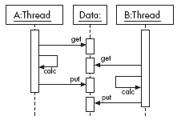
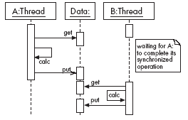
Example of a synchronized method
a) Abnormal: The value put by
b) The problem has been solved
thread A is immediately
by accessing the data using
overwritten by the value put
synchronized methods
by thread B.

Slide 40
10.6 Defects in Handling Stress and Unusual Situations
Insufficient throughput or response time on minimal configurations
  Defect:
    On a minimal configuration, the system’s throughput or response time fail to meet requirements.
  Testing strategy:
    Perform testing using minimally configured platforms.

Slide 41
Defects in Handling Stress and Unusual Situations
Incompatibility with specific configurations of hardware or software
  Defect:
    The system fails if it is run using particular configurations of hardware, operating systems and external libraries.
  Testing strategy:
    Extensively execute the system with all possible configurations that might be encountered by users.

Slide 42
Defects in Handling Stress and Unusual Situations
Defects in handling peak loads or missing resources
  Defects:
    The system does not gracefully handle resource shortage.
    Resources that might be in short supply include:
      memory, disk space or network bandwidth, permission.
    The program being tested should report the problem in a way the user will understand.
  Testing strategies:
    Devise a method of denying the resources.
    Run a very large number of copies of the program being tested, all at the same time.

Slide 43
Defects in Handling Stress and Unusual Situations
Inappropriate management of resources
  Defect:
    A program uses certain resources but does not make them available when it no longer needs them.
  Testing strategy:
    Run the program intensively in such a way that it uses many resources, relinquishes them and then uses them again repeatedly.

Slide 44
Defects in Handling Stress and Unusual Situations
Defects in the process of recovering from a crash
  Defects:
    Any system will undergo a sudden failure if its hardware fails, or if its power is turned off.
    It is a defect if the system is left in an unstable state and hence is unable to fully recover.
    It is also a defect if a system does not correctly deal with the crashes of related systems.
  Testing strategies:
    Kill a program at various times during execution.
    Try turning the power off, however operating systems themselves are often intolerant of doing that.

Slide 45
10.7 Documentation defects
  Defect:
    The software has a defect if the user manual, reference manual or on-line help:
      gives incorrect information
      fails to give information relevant to a problem.
  Testing strategy:
    Examine all the end-user documentation, making sure it is correct.
    Work through the use cases, making sure that each of them is adequately explained to the user.

Slide 46
10.8 Writing Formal Test Cases and Test Plans
A test case is an explicit set of instructions designed to detect a particular class of defect in a software system.
  A test case can give rise to many tests.
  Each test is a particular running of the test case on a particular version of the system.

Slide 47
Test plans
A test plan is a document that contains a complete set of test cases for a system
    Along with other information about the testing process.
  The test plan is one of the standard forms of documentation.
  If a project does not have a test plan:
    Testing will inevitably be done in an ad-hoc manner.
    Leading to poor quality software.
  The test plan should be written long before the testing starts.
  You can start to develop the test plan once you have developed the requirements.

Slide 48
Information to include in a formal test case
  A. Identification and classification:
    Each test case should have a number, and may also be given a descriptive title.
    The system, subsystem or module being tested should also be clearly indicated.
    The importance of the test case should be indicated.
  B. Instructions:
    Tell the tester exactly what to do.
    The tester should not normally have to refer to any documentation in order to execute the instructions.
  C. Expected result:
    Tells the tester what the system should do in response to the instructions.
    The tester reports a failure if the expected result is not encountered.
  D. Cleanup (when needed):
    Tells the tester how to make the system go ‘back to normal’ or shut down after the test.

Slide 49
Levels of importance of test cases
  Level 1:
    First pass critical test cases.
    Designed to verify the system runs and is safe.
    No further testing is possible.
  Level 2:
    General test cases.
    Verify that day-to-day functions correctly.
    Still permit testing of other aspects of the system.
  Level 3:
    Detailed test cases.
    Test requirements that are of lesser importance.
    The system functions most of the time but has not yet met quality objectives.

Slide 50
Determining test cases by enumerating attributes
It is important that the test cases test every aspect of the requirements.
  Each detail in the requirements is called an attribute.
    An attribute can be thought of as something that is testable.
    A good first step when creating a set of test cases is to enumerate the attributes.
    A way to enumerate attributes is to circle all the important points in the requirements document.
  However there are often many attributes that are implicit.

Slide 51
10.9 Strategies for Testing Large Systems
Big bang testing versus integration testing
  In big bang testing, you take the entire system and test it as a unit
  A better strategy in most cases is incremental testing:
    You test each individual subsystem in isolation
    Continue testing as you add more and more subsystems to the final product
    Incremental testing can be performed horizontally or vertically, depending on the architecture
      Horizontal testing can be used when the system is divided into separate sub-applications

Slide 52
Top down testing
  Start by testing just the user interface.
  The underlying functionality are simulated by stubs.
    Pieces of code that have the same interface as the lower level functionality.
    Do not perform any real computations or manipulate any real data.
  Then you work downwards, integrating lower and lower layers.
  The big drawback to top down testing is the cost of writing the stubs.

Slide 53
Bottom-up testing
  Start by testing the very lowest levels of the software.
  You needs drivers to test the lower layers of software.
    Drivers are simple programs designed specifically for testing that make calls to the lower layers.
  Drivers in bottom-up testing have a similar role to stubs in top-down testing, and are time-consuming to write.

Slide 54
Sandwich testing
  Sandwich testing is a hybrid between bottom-up and top down testing.
  Test the user interface in isolation, using stubs.
  Test the very lowest level functions, using drivers.
  When the complete system is integrated, only the middle layer remains on which to perform the final set of tests.

Slide 55
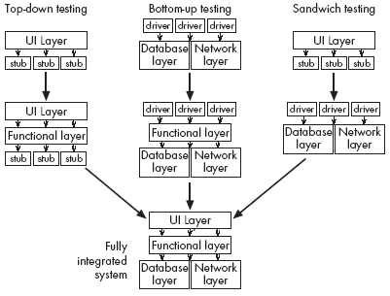
Vertical strategies for incremental integration testing

Slide 56
The test-fix-test cycle
When a failure occurs during testing:
  Each failure report is entered into a failure tracking system.
  It is then screened and assigned a priority.
  Low-priority failures might be put on a known bugs list that is included with the software’s release notes.
  Some failure reports might be merged if they appear to result from the same defects.
  Somebody is assigned to investigate a failure.
  That person tracks down the defect and fixes it.
  Finally a new version of the system is created, ready to be tested again.

Slide 57
The ripple effect
There is a high probability that the efforts to remove the defects may have actually added new defects
  The maintainer tries to fix problems without fully understanding the ramifications of the changes
  The maintainer makes ordinary human errors
  The system regresses into a more and more failure-prone state

Slide 58
Regression testing
  It tends to be far too expensive to re-run every single test case every time a change is made to software.
  Hence only a subset of the previously-successful test cases is actually re-run.
  This process is called regression testing.
    The tests that are re-run are called regression tests.
  Regression test cases are carefully selected to cover as much of the system as possible.
The “law of conservation of bugs”:
  The number of bugs remaining in a large system is proportional to the number of bugs already fixed

Slide 59
Deciding when to stop testing
  All of the level 1 test cases must have been successfully executed.
  Certain pre-defined percentages of level 2 and level 3 test cases must have been executed successfully.
  The targets must have been achieved and are maintained for at least two cycles of ‘builds’.
    A build involves compiling and integrating all the components.
    Failure rates can fluctuate from build to build as:
      Different sets of regression tests are run.
      New defects are introduced.

Slide 60
The roles of people involved in testing
  The first pass of unit and integration testing is called developer testing.
    Preliminary testing performed by the software developers who do the design.
  Independent testing is performed by a separate group.
    They do not have a vested interest in seeing as many test cases pass as possible.
    They develop specific expertise in how to do good testing, and how to use testing tools.

Slide 61
Testing performed by users and clients
  Alpha testing
    Performed by the user or client, but under the supervision of the software development team.
  Beta testing
    Performed by the user or client in a normal work environment.
    Recruited from the potential user population.
    An open beta release is the release of low-quality software to the general population.
  Acceptance testing
    Performed by users and customers.
    However, the customers do it on their own initiative.

Slide 62
10.10 Inspections
An inspection is an activity in which one or more people systematically
  Examine source code or documentation, looking for defects.
  Normally, inspection involves a meeting...
    Although participants can also inspect alone at their desks.

Slide 63
Roles on inspection teams
  The author
  The moderator.
    Calls and runs the meeting.
    Makes sure that the general principles of inspection are adhered to.
  The secretary.
    Responsible for recording the defects when they are found.
    Must have a thorough knowledge of software engineering.
  Paraphrasers.
    Step through the document explaining it in their own words.

Slide 64
Principles of inspecting
  Inspect the most important documents of all types
    code, design documents, test plans and requirements
  Choose an effective and efficient inspection team
    between two and five people
    Including experienced software engineers
  Require that participants prepare for inspections
    They should study the documents prior to the meeting and come prepared with a list of defects
  Only inspect documents that are ready
    Attempting to inspect a very poor document will result in defects being missed

Slide 65
Principles of inspecting
  Avoid discussing how to fix defects
    Fixing defects can be left to the author
  Avoid discussing style issues
    Issues like are important, but should be discussed separately
  Do not rush the inspection process
    A good speed to inspect is
      200 lines of code per hour (including comments)
      or ten pages of text per hour

Slide 66
Principles of inspecting
  Avoid making participants tired
    It is best not to inspect for more than two hours at a time, or for more than four hours a day
  Keep and use logs of inspections
    You can also use the logs to track the quality of the design process
  Re-inspect when changes are made
    You should re-inspect any document or code that is changed more than 20%

Slide 67
A peer-review process
Managers are normally not involved
  This allows the participants to express their criticisms more openly, not fearing repercussions
  The members of an inspection team should feel they are all working together to create a better document
  Nobody should be blamed

Slide 68
Conducting an inspection meeting
1. The moderator calls the meeting and distributes the documents.
2. The participants prepare for the meeting in advance.
3. At the start of the meeting, the moderator explains the procedures and verifies that everybody has prepared.
4. Paraphrasers take turns explaining the contents of the document or code, without reading it verbatim.
  Requiring that the paraphraser not be the author ensures that the paraphraser say what he or she sees, not what the author intended to say.
5. Everybody speaks up when they notice a defect.

Slide 69
Inspecting compared to testing
  Both testing and inspection rely on different aspects of human intelligence.
  Testing can find defects whose consequences are obvious but which are buried in complex code.
  Inspecting can find defects that relate to maintainability or efficiency.
  The chances of mistakes are reduced if both activities are performed.

Slide 70
Testing or inspecting, which comes first?
  It is important to inspect software before extensively testing it.
  The reason for this is that inspecting allows you to quickly get rid of many defects.
  If you test first, and inspectors recommend that redesign is needed, the testing work has been wasted.
    There is a growing consensus that it is most efficient to inspect software before any testing is done.
  Even before developer testing

Slide 71
10.11 Quality Assurance in General
Root cause analysis
  Determine whether problems are caused by such factors as
    Lack of training
    Schedules that are too tight
    Building on poor designs or reusable technology

Slide 72
Measure quality and strive for continual improvement
Things you can measure regarding the quality of a software product, and indirectly of the quality of the process
  The number of failures encountered by users.
  The number of failures found when testing a product.
  The number of defects found when inspecting a product.
  The percentage of code that is reused.
    More is better, but don’t count clones.
  The number of questions posed by users to the help desk.
    As a measure of usability and the quality of documentation.

Slide 73
Post-mortem analysis
Looking back at a project after it is complete, or after a release,
  You look at the design and the development process
  Identify those aspects which, with benefit of hindsight, you could have done better
  You make plans to do better next time

Slide 74
Process standards
The personal software process (PSP):
  Defines a disciplined approach that a developer can use to improve the quality and efficiency of his or her personal work.
  One of the key tenets is personally inspecting your own work.
The team software process (TSP):
  Describes how teams of software engineers can work together effectively.
The software capability maturity model (CMM):
  Contains five levels, Organizations start in level 1, and as their processes become better they can move up towards level 5.
ISO 9000-2:
  An international standard that lists a large number of things an organization should do to improve their overall software process.

Slide 75
10.12 Detailed Example: Test cases for Phase 2 of the SimpleChat
General Setup for Test Cases in the 2000 Series
System: SimpleChat/OCSF Phase: 2
Instructions:
Install Java, minimum release 1.2.0, on Windows 95, 98 or ME.
Install Java, minimum release 1.2.0, on Windows NT or 2000.
Install Java, minimum release 1.2.0, on a Solaris system.
Install the SimpleChat - Phase 2 on each of the above platforms.

Slide 76
Test cases for Phase 2 of the SimpleChat
Test Case 2001
System: SimpleChat Phase: 2
Server startup check with default arguments
Severity: 1
Instructions:
1. At the console, enter: java EchoServer.
Expected result:
1. The server reports that it is listening for clients by displaying the
following message:
Server listening for clients on port 5555
2. The server console waits for user input.
Cleanup:
1. Hit CTRL+C to kill the server.

Slide 77
Test cases for Phase 2 of the SimpleChat
Test Case 2002
System: SimpleChat Phase: 2
Client startup check without a login
Severity: 1
Instructions:
1. At the console, enter: java ClientConsole.
Expected result:
1. The client reports it cannot connect without a login by displaying:
ERROR - No login ID specified. Connection aborted.
2. The client terminates.
Cleanup: (if client is still active)
1. Hit CTRL+C to kill the client.

Slide 78
Test cases for Phase 2 of the SimpleChat
Test Case 2003
System: SimpleChat Phase: 2
Client startup check with a login and without a server
Severity: 1
Instructions:
1. At the console, enter: java ClientConsole <loginID>
  where <loginID> is the name you wish to be identified by.
Expected result:
1. The client reports it cannot connect to a server by displaying:
  Cannot open connection. Awaiting command.
2. The client waits for user input
Cleanup: (if client is still active)
1. Hit CTRL+C to kill the client.

Slide 79
Test cases for Phase 2 of the SimpleChat
Test Case 2007
System: SimpleChat Phase: 2
Server termination command check
Severity: 2
Instructions:
1. Start a server (Test Case 2001 instruction 1) using default arguments.
2. Type #quit into the server's console.
Expected result:
1. The server quits.
Cleanup (If the server is still active):
1. Hit CTRL+C to kill the server.

Slide 80
Test cases for Phase 2 of the SimpleChat
Test Case 2013
System: SimpleChat Phase: 2
Client host and port setup commands check
Severity: 2
Instructions:
1. Start a client without a server (Test Case 2003).
2. At the client's console, type #sethost <newhost> where
<newhost> is the name of a computer on the network
3. At the client’s console, type #setport 1234.
Expected result:
1. The client displays
Host set to: <newhost>
Port set to: 1234.
Cleanup:
1. Type #quit to kill the client.

Slide 81
Test cases for Phase 2 of the SimpleChat
Test Case 2019
System: SimpleChat Phase: 2
Different platform tests
Severity: 3
Instructions:
1. Repeat test cases 2001 to 2018 on Windows 95, 98, NT or 2000, and Solaris
Expected results:
1. The same as before.

Slide 82
10.13 Difficulties and Risks in Quality Assurance
It is very easy to forget to test some aspects of a software system:
    ‘running the code a few times’ is not enough.
    Forgetting certain types of tests diminishes the system’s quality.
There is a conflict between achieving adequate quality levels, and ‘getting the product out of the door’
    Create a separate department to oversee QA.
    Publish statistics about quality.
    Build adequate time for all activities.

Slide 83
Difficulties and Risks in Quality Assurance
People have different abilities and knowledge when it comes to quality
    Give people tasks that fit their natural personalities.
    Train people in testing and inspecting techniques.
    Give people feedback about their performance in terms of producing quality software.
    Have developers and maintainers work for several months on a testing team.

